Slide 1
Splay Trees

Slide 2
Outline
This topic covers splay trees
  A binary search tree
  An alternate idea to optimizing run times
  A possible height of O(n) but amortized run times of Θ(ln(n))
  Each access or insertion moves that node to the root
  Operations are zig-zag and zig-zig
  Similar to, but different from, AVL trees

Slide 3
Background
AVL trees and red-black trees are binary search trees with logarithmic height
  This ensures all operations are O(ln(n))
An alternative to maintaining a height logarithmic with respect to the number of nodes, an alternative idea is to make use of an old maxim:
  Data that has been recently accessed is more likely to
  be accessed again in the near future.

Slide 4
Background
Accessed nodes could be rotated or splayed to the root of the tree:
  Accessed nodes are splayed to the root during the count/find operation
  Inserted nodes are inserted normally and then splayed
  The parent of a removed node is splayed to the root
Invented in 1985 by Daniel Dominic Sleator and Robert Endre Tarjan

Slide 5
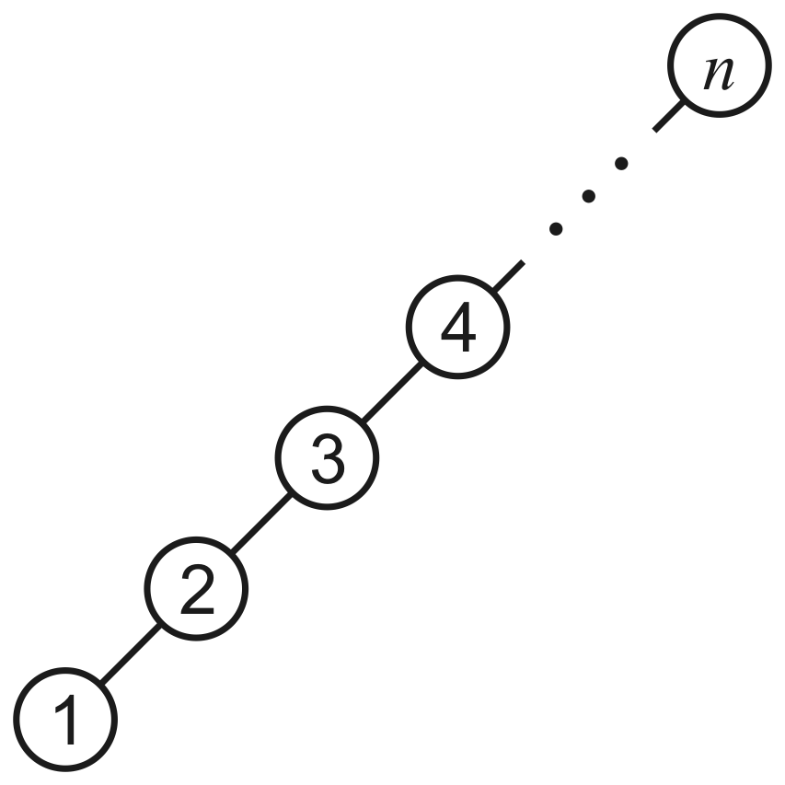
Insertion at the Root
Immediately, inserting at the root makes it clear that we will still have access times that are O(n):
  Insert the values 1, 2, 3, 4, …, n, in that order
  Now, an access to 1 requires that a linked list be traversed

Slide 6
Inserting at the Root
However, we are interested in amortized run times:
  We only require that n accesses have Θ(n ln(n)) time
  Thus O(ln(n)) of those accesses could still be O(n)

Slide 7
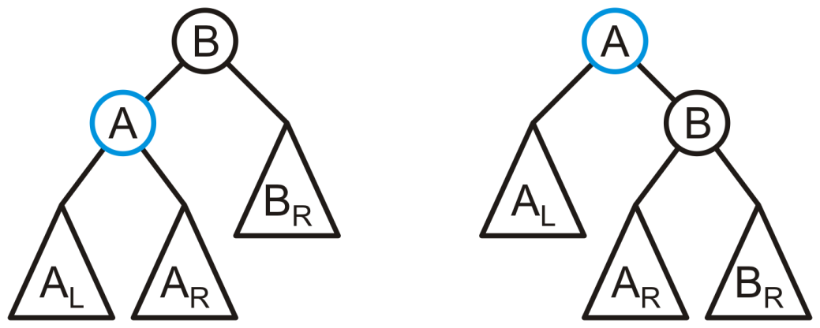
Inserting at the Root
Before we consider insertions, how can we simply move an access node to the root?
  We could consider AVL rotations, the simplest of which is:

Slide 8
Single Rotations
Unfortunately, as we will see, using just single rotations does not work

Slide 9
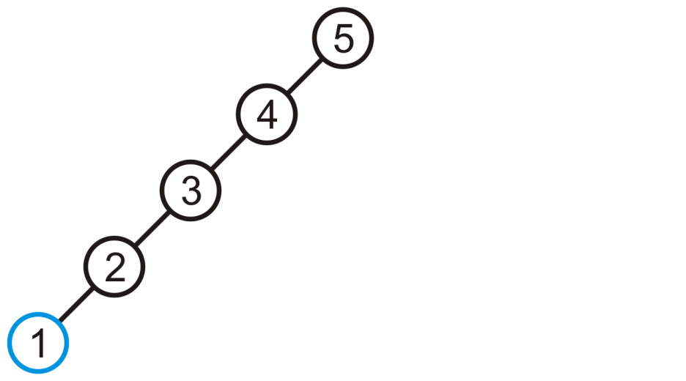
Single Rotations
Consider this splay tree with five entries
  They were inserted in the order 1, 2, 3, 4 and 5
  Let us access 1 by find it and then rotating it back to the root

Slide 10
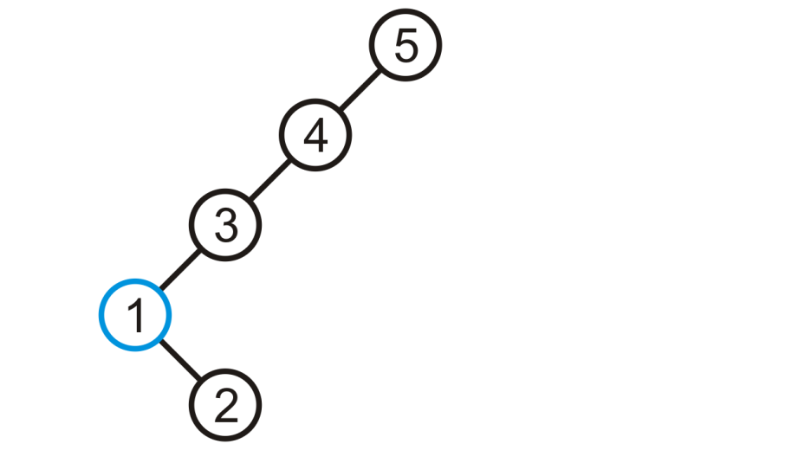
Single Rotations
Rotating 1 and 2

Slide 11
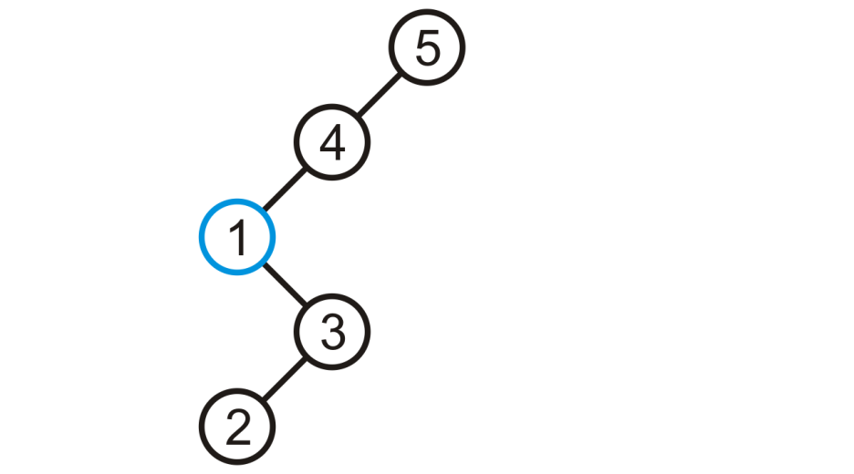
Single Rotations
Rotating 1 and 3

Slide 12
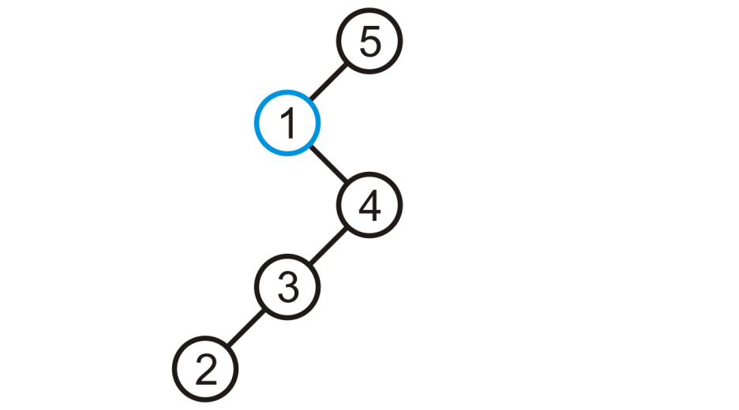
Single Rotations
Rotating 1 and 4

Slide 13
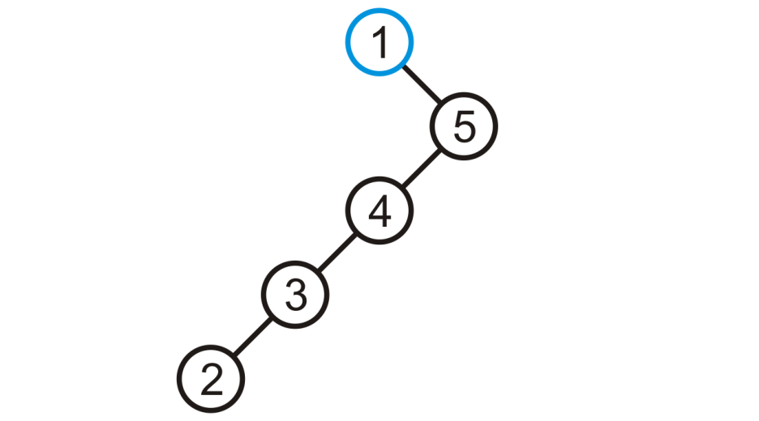
Single Rotations
Rotating 1 and 5
  The result still looks like a linked list

Slide 14
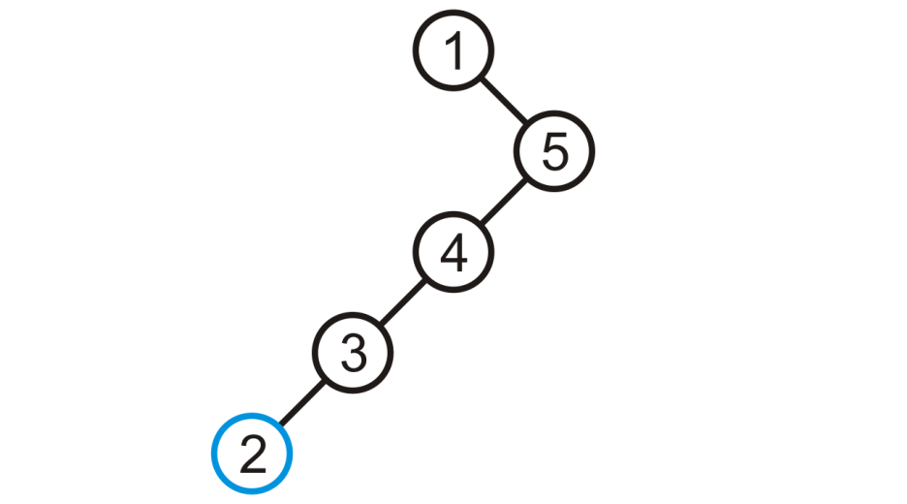
Single Rotations
Accessing 2 next doesn’t do much

Slide 15
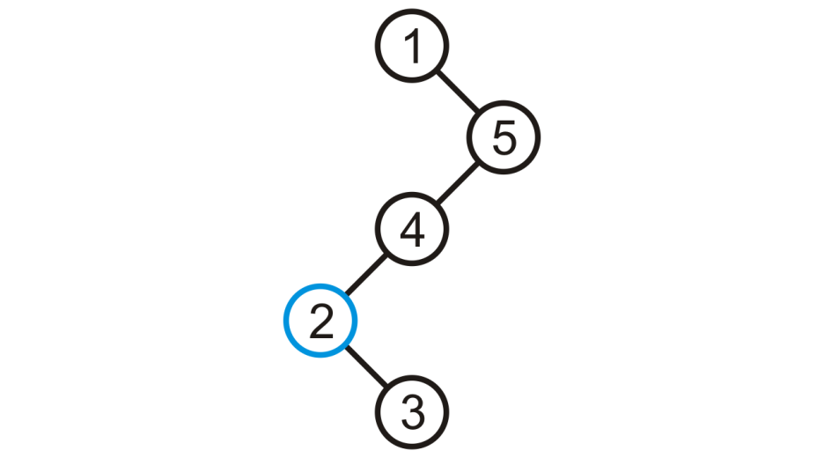
Single Rotations
Accessing 2 next doesn’t do much

Slide 16
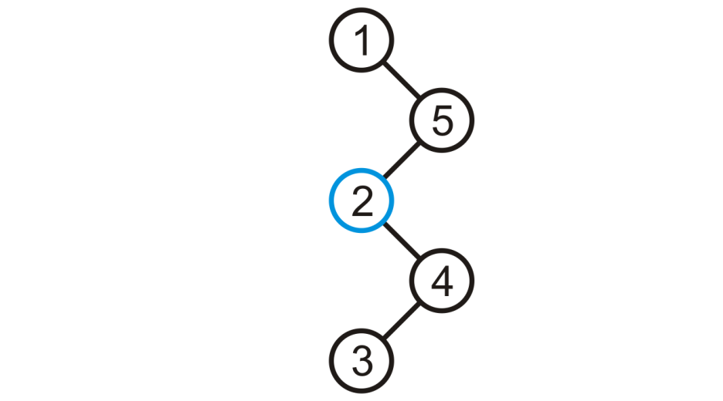
Single Rotations
Accessing 2 next doesn’t do much

Slide 17
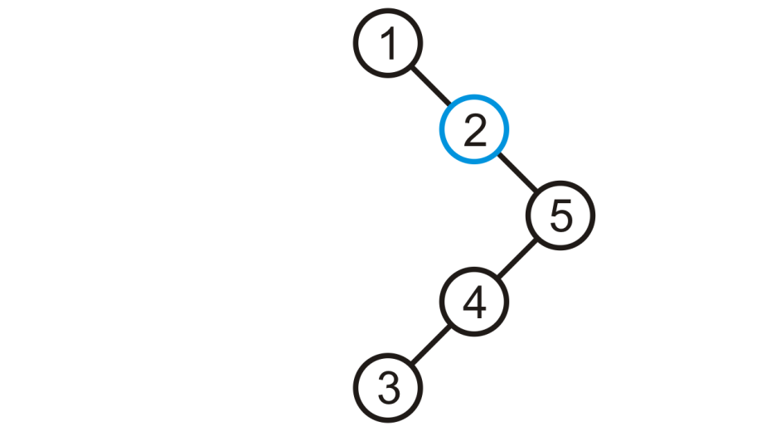
Single Rotations
Accessing 2 next doesn’t do much

Slide 18
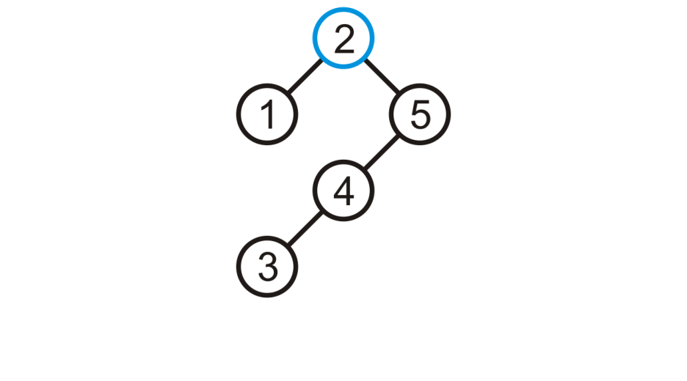
Single Rotations
Accessing 2 next doesn’t do much
  The resulting tree is shallower by only 1

Slide 19
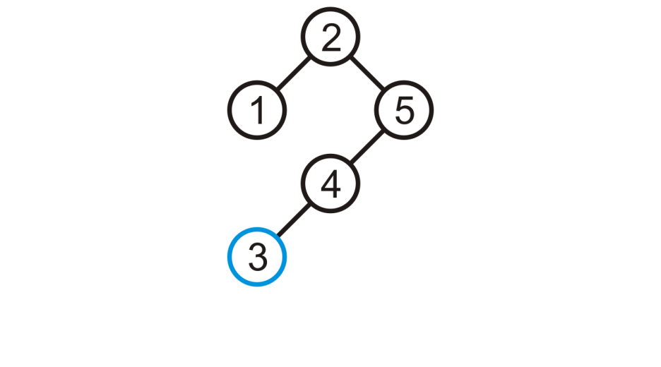
Single Rotations
Accessing 3 isn’t significant, either

Slide 20
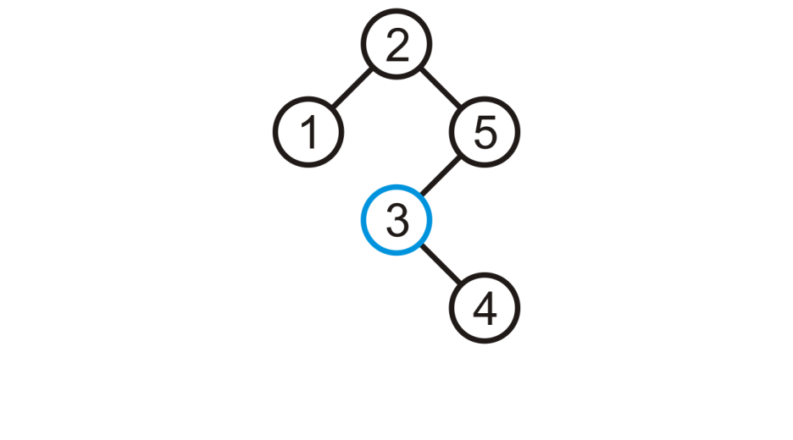
Single Rotations
Accessing 3 isn’t significant, either

Slide 21
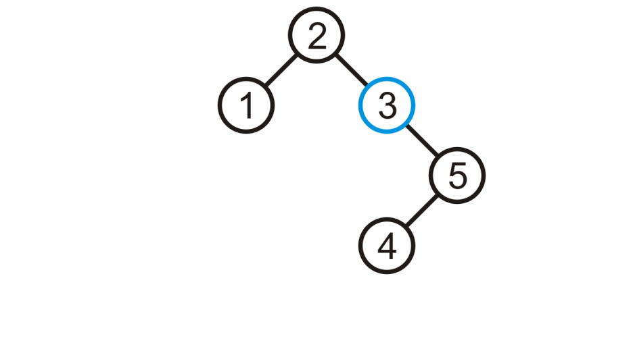
Single Rotations
Accessing 3 isn’t significant, either

Slide 22
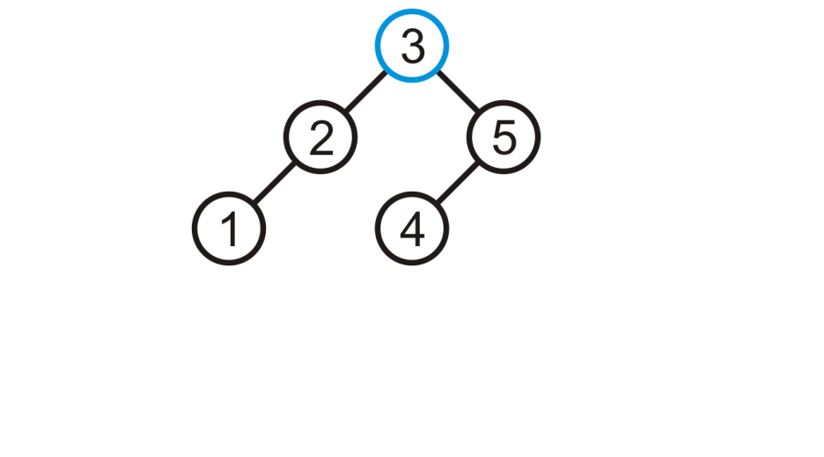
Single Rotations
Accessing 3 isn’t significant, either
  Essentially, it is two linked lists and the left sub-tree is turning into the original linked list

Slide 23
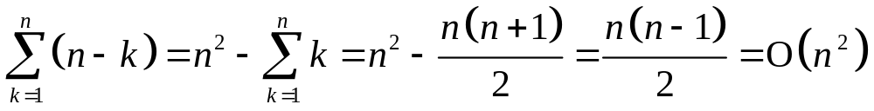
Single Rotations
In a general splay tree created in the order
1, 2, 3, 4, …, n
and then accessed repeated in the order
1, 2, 3, 4, …, n
will require
comparisons—an amortized run time of O(n)

Slide 24
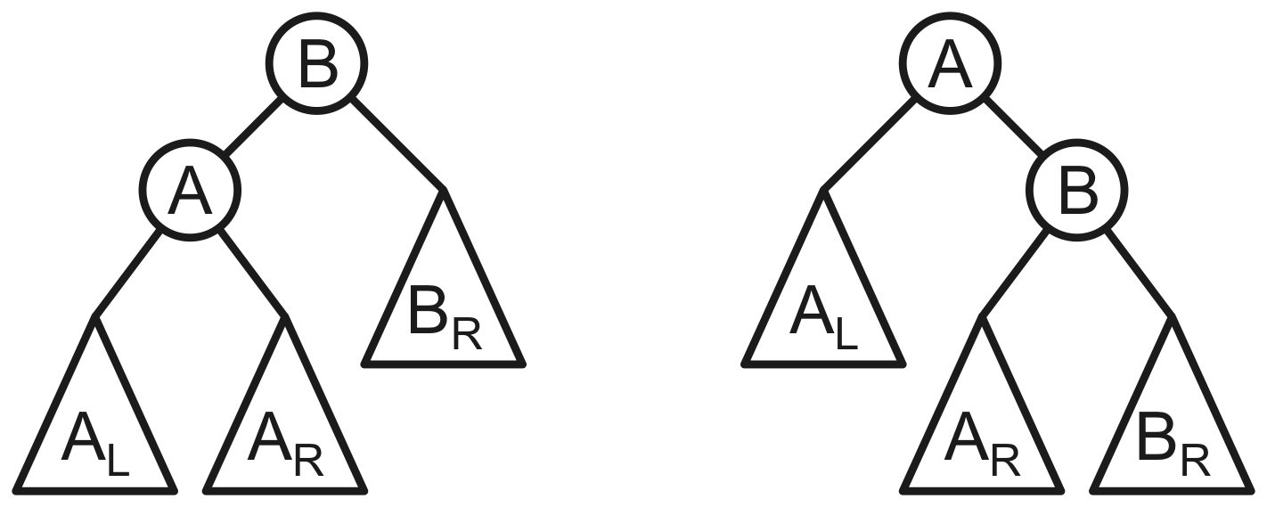
Single Rotations
Thus, a single rotation will not do
  It can convert a linked list into a linked list

Slide 25
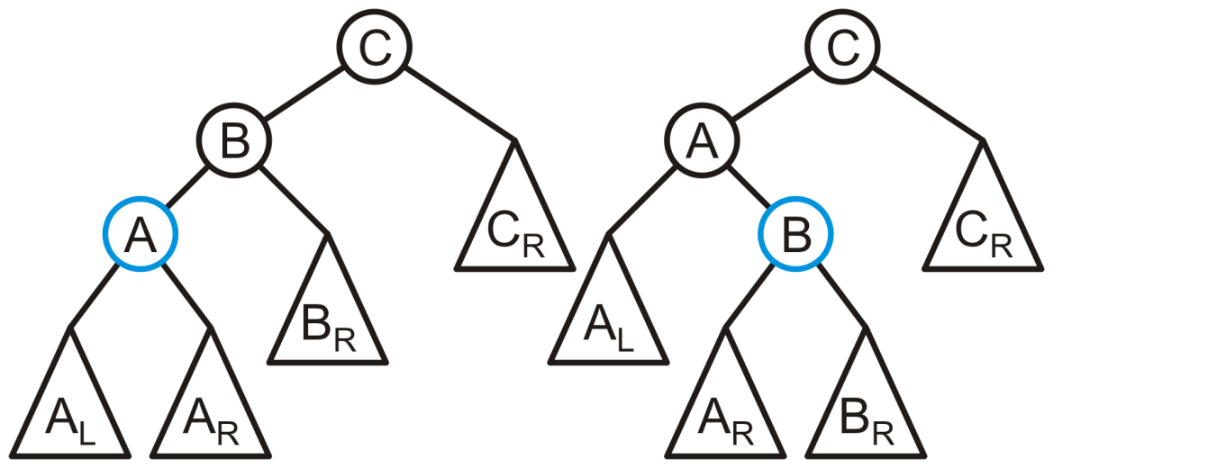
Depth-2 Rotations
Let’s try rotations with entries at depth 2
  Suppose we are accessing A on the left and B on the right

Slide 26
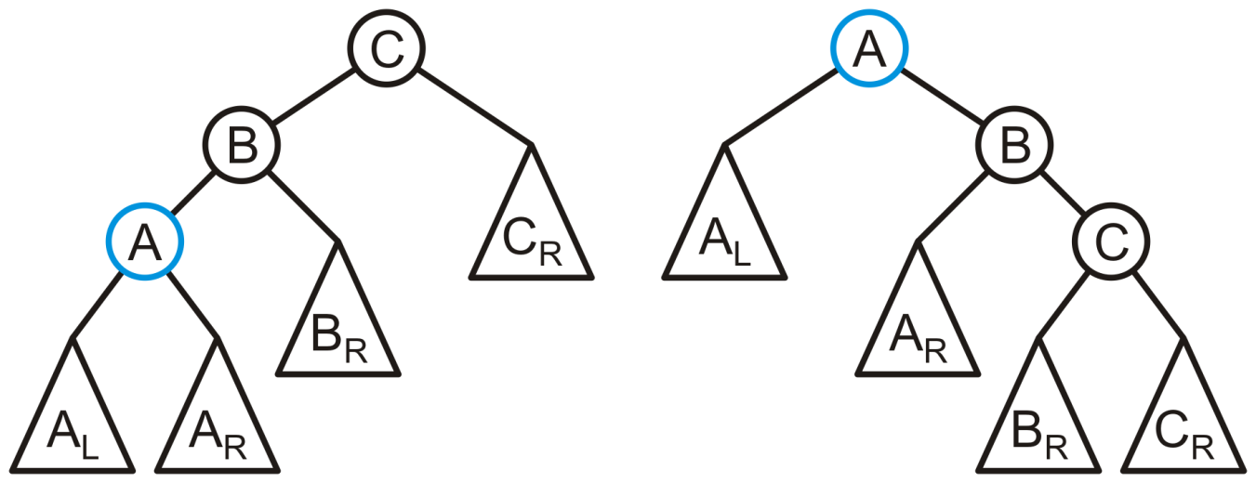
Depth-2 Rotations
In the first case, two rotations at the root bring A to the root
  We will call this a zig-zig rotation

Slide 27
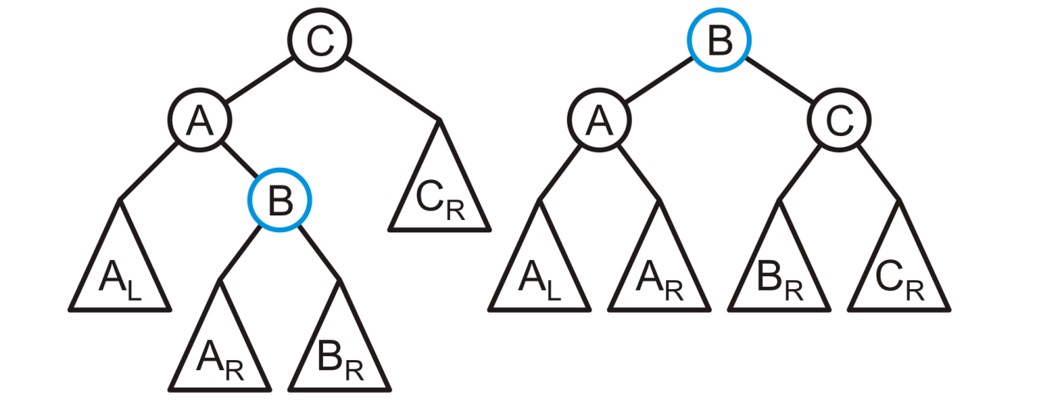
Depth-2 Rotations
In the second, two rotations bring B to the root
  It doesn’t seem we’ve done a lot…
  We will call this a zig-zag rotation

Slide 28
Depth-2 Rotations
If the accessed node is a child of the root, we must revert to a single rotation:
  A zig rotation

Slide 29
Operations
Accessing any node splays the node to the root
Inserting a new element into a splay tree follows the binary search tree model:
  Insert the node as per a standard binary search tree
  Splay the object to the root
Removing a node also follows the pattern of a binary search tree
  Copy the minimum of the right sub-tree
  Splay the parent of the removed node to the root

Slide 30
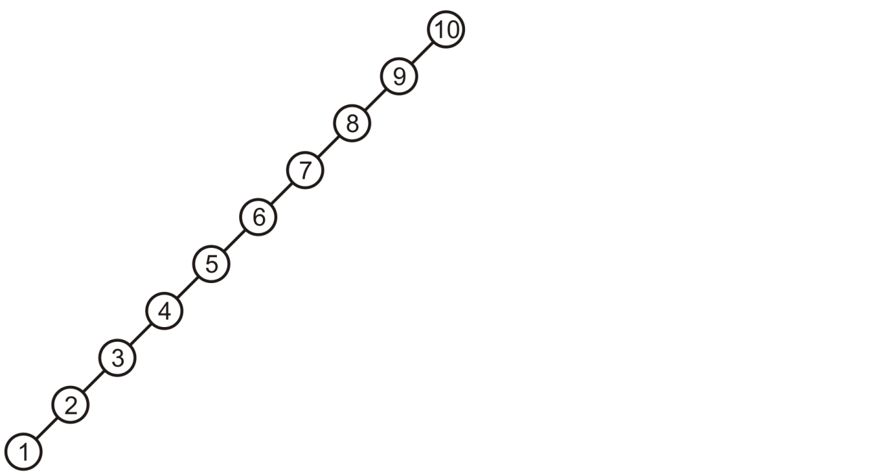
Examples
With a little consideration, it becomes obvious that inserting 1 through 10, in that order, will produce the splay tree

Slide 31
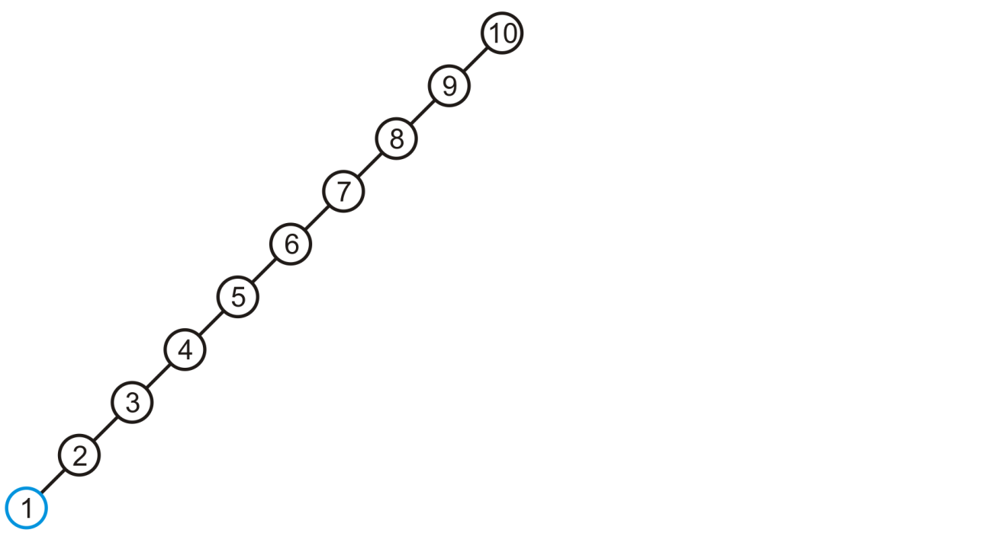
Examples
We will repeatedly access the deepest node in the tree
  With each operation, this node will be splayed to the root
  We begin with a zig-zig rotation

Slide 32
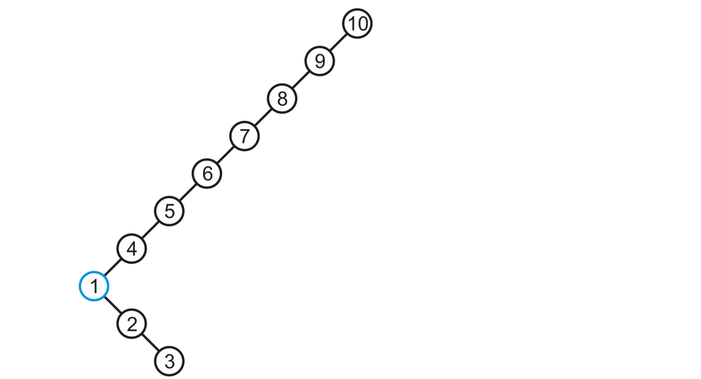
Examples
This is followed by another zig-zig operation...

Slide 33
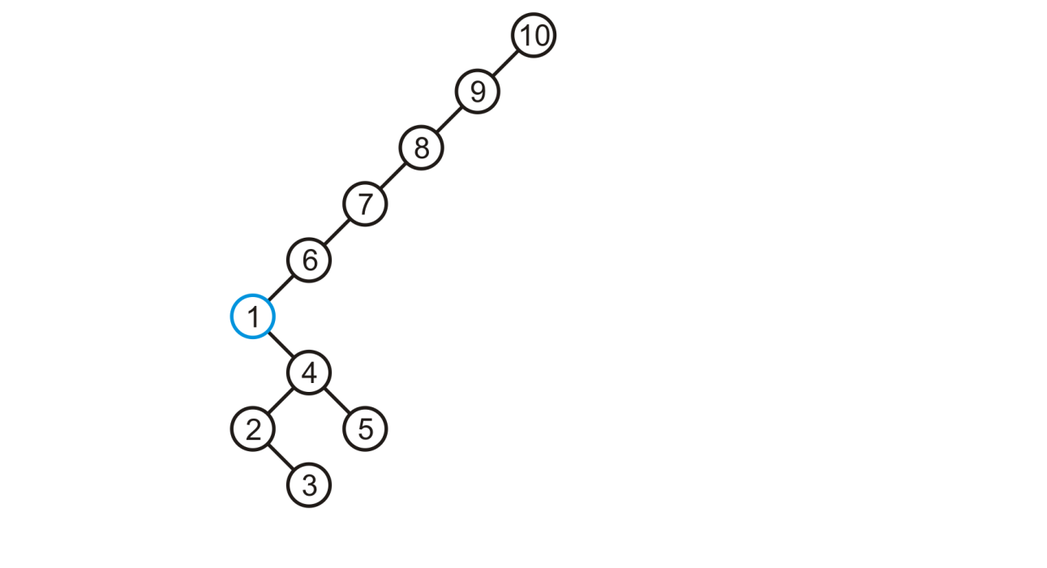
Examples
...and another

Slide 34
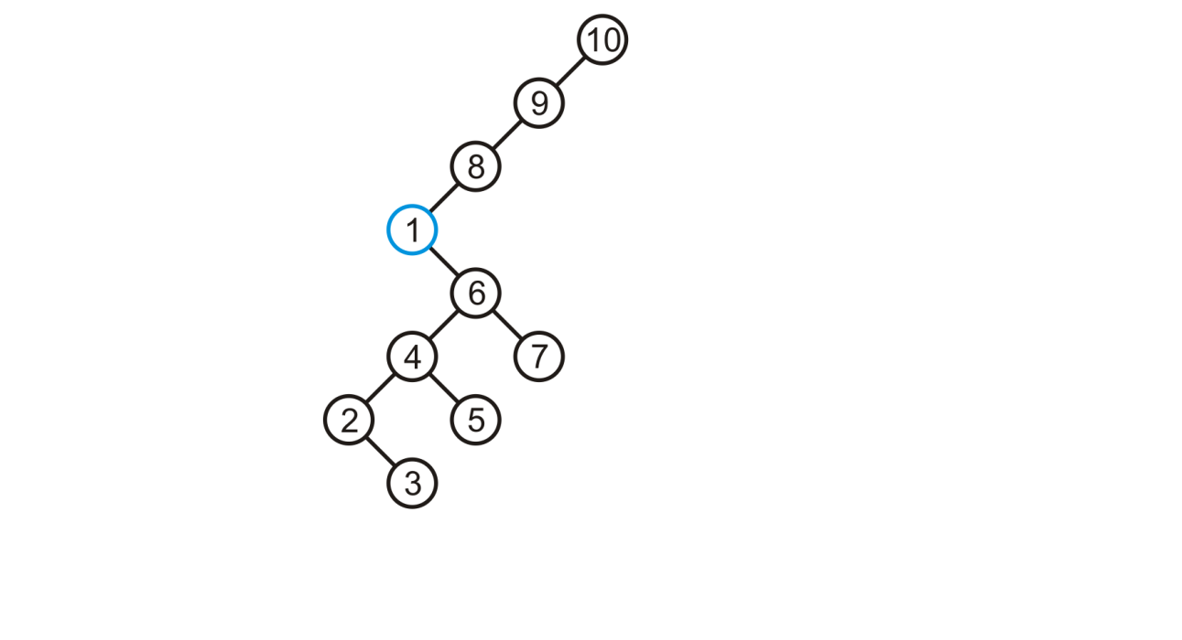
Examples
...and another

Slide 35
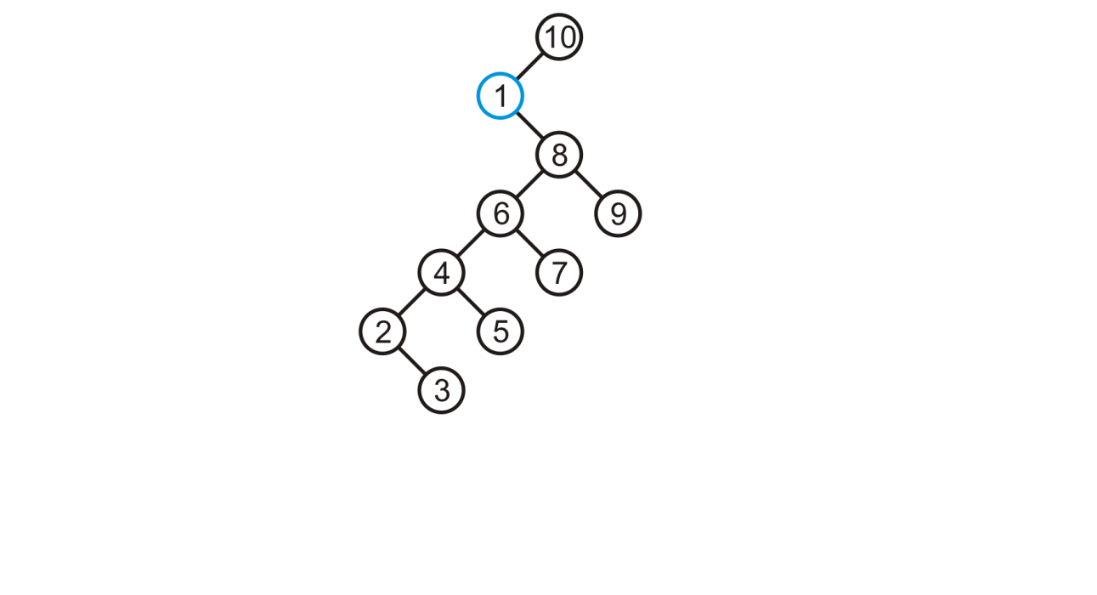
Examples
At this point, this requires a single zig operation to bring 1 to the root

Slide 36
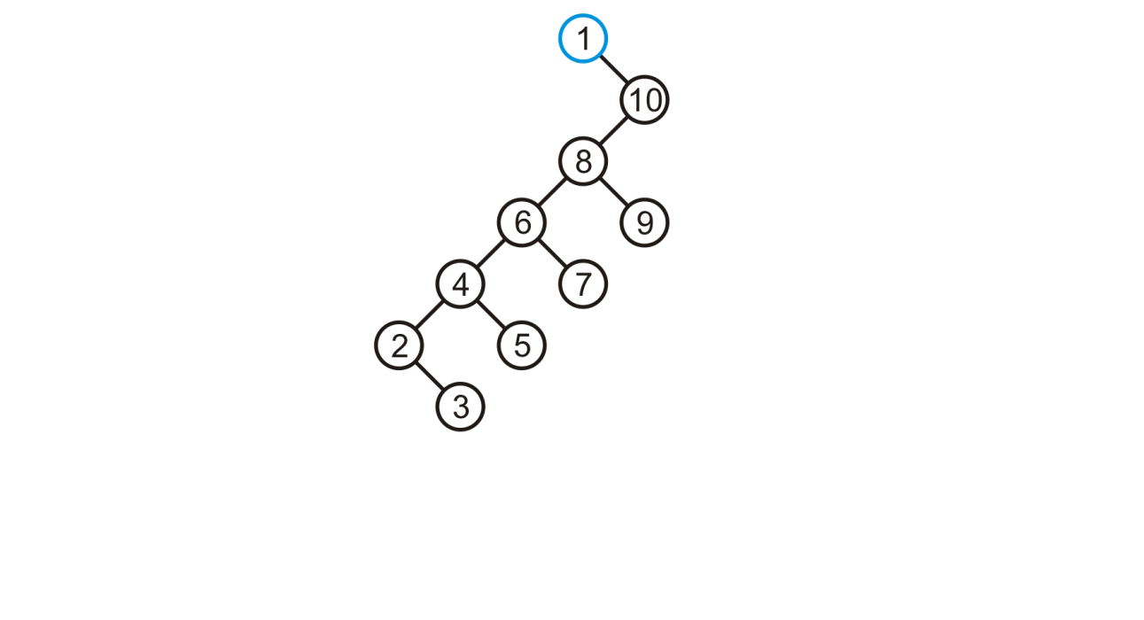
Examples
The height of this tree is now 6 and no longer 9

Slide 37
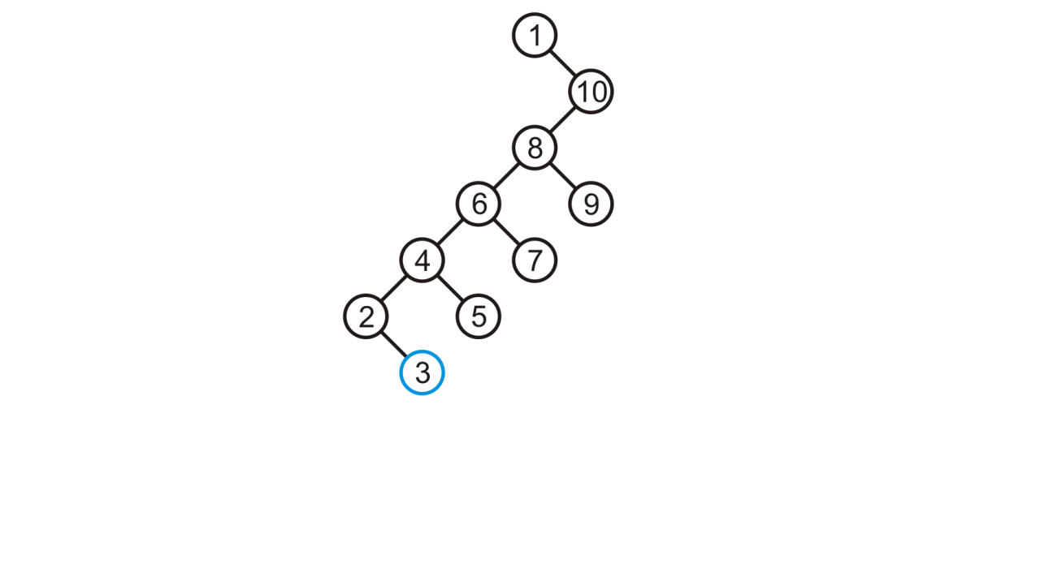
Examples
The deepest node is now 3:
  This node must be splayed to the root beginning with a zig-zag operation

Slide 38
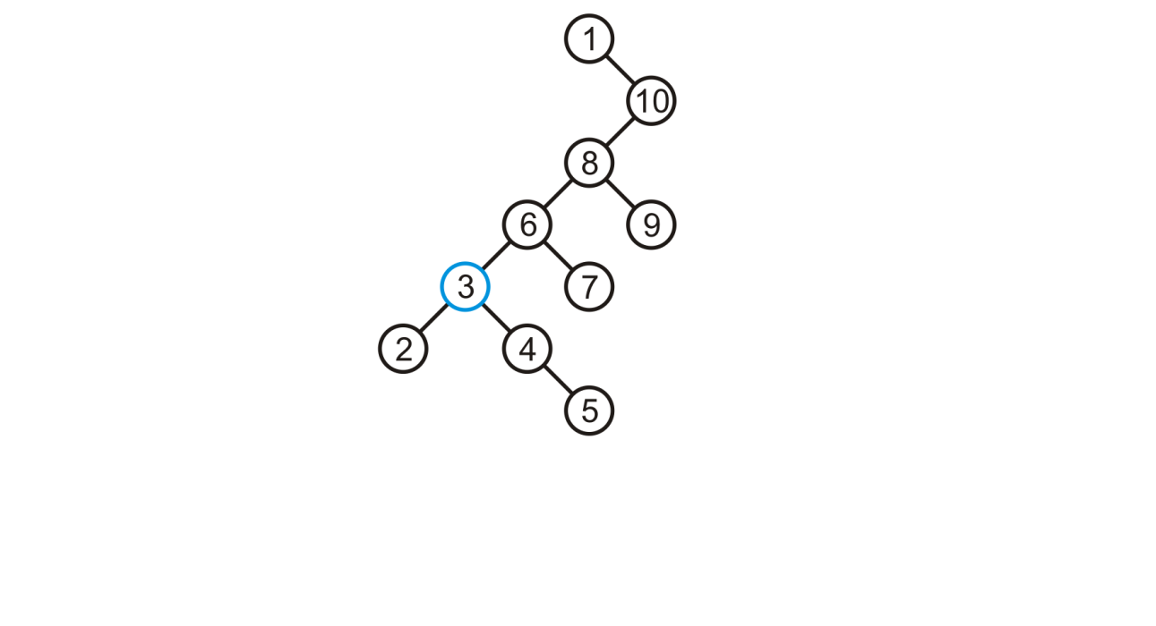
Examples
The node 3 is rotated up
  Next we require a zig-zig operation

Slide 39
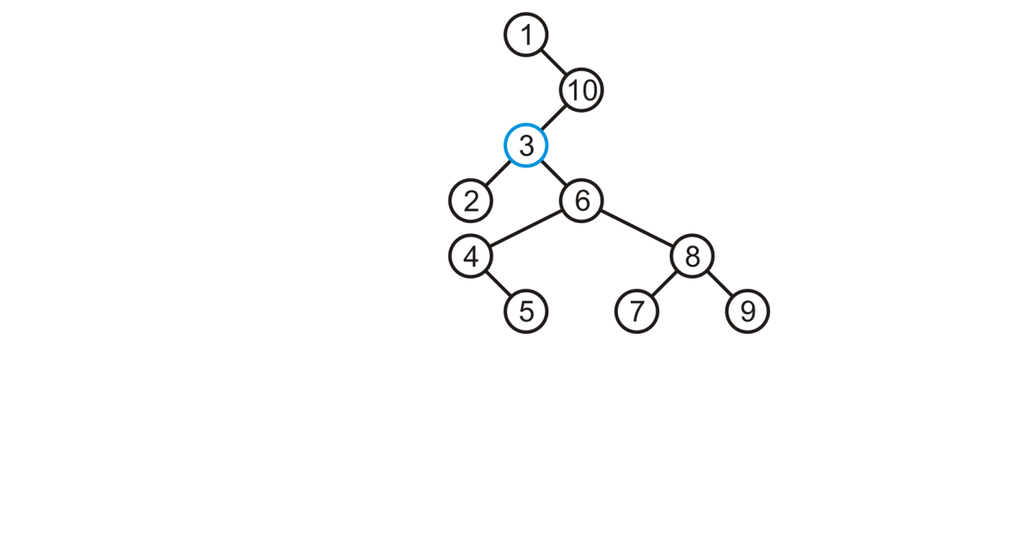
Examples
Finally, to bring 3 to the root, we need a zig-zag operation

Slide 40
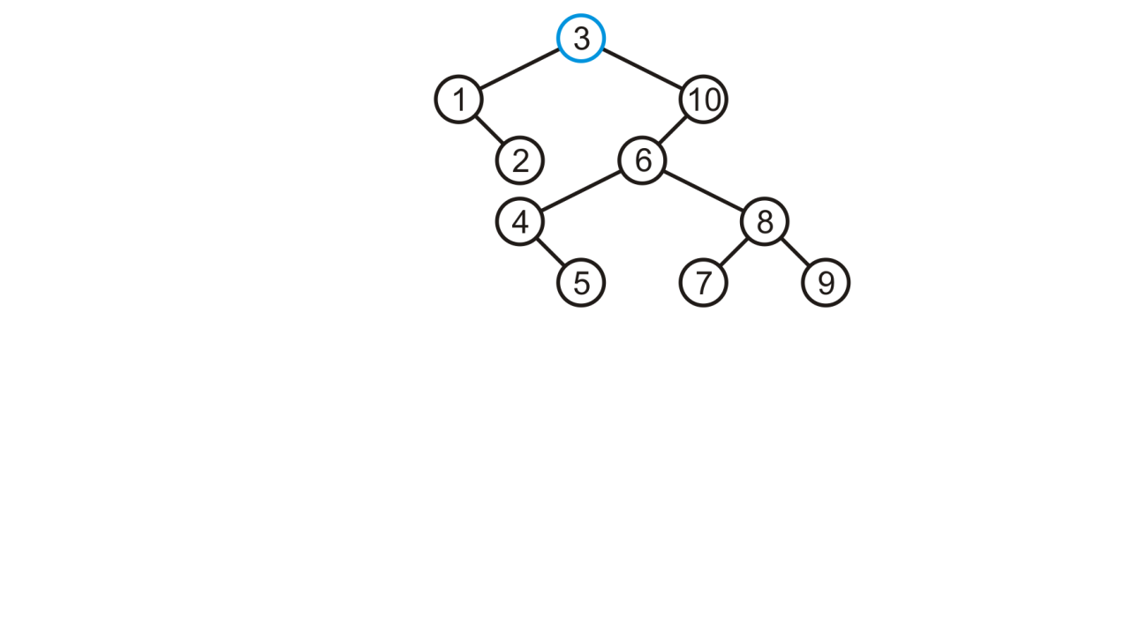
Examples
The height of this tree is only 4

Slide 41
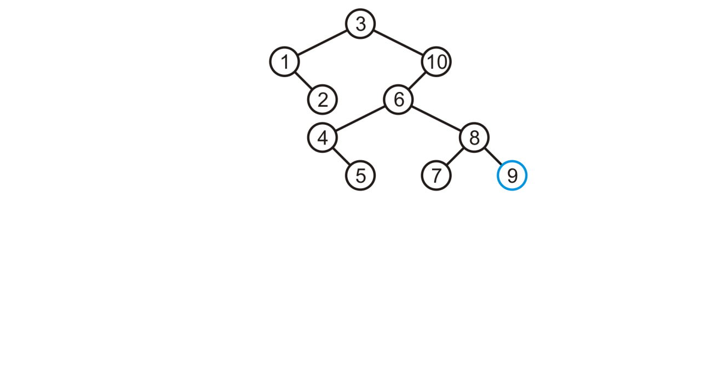
Examples
Of the three deepest nodes, 9 requires a zig-zig operation, so will access it next
  The zig-zig operation will push 6 and its left sub-tree down

Slide 42
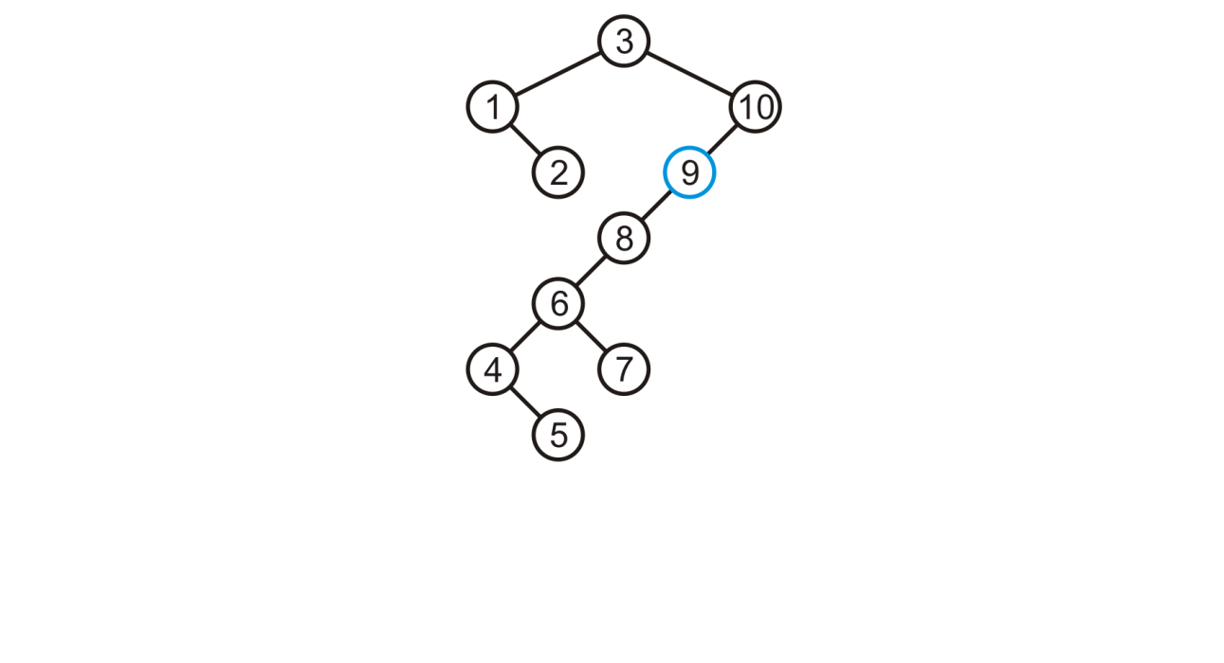
Examples
This is closer to a linked list; however, we’re not finished
  A zig-zag operation will move 9 to the root

Slide 43
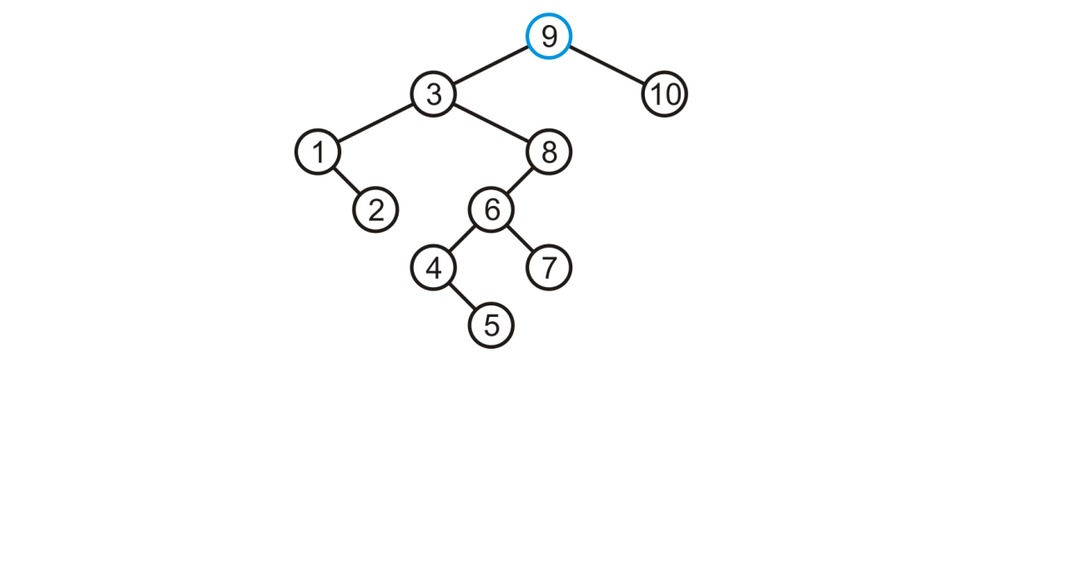
Examples
In this case, the height of the tree is now greater: 5

Slide 44
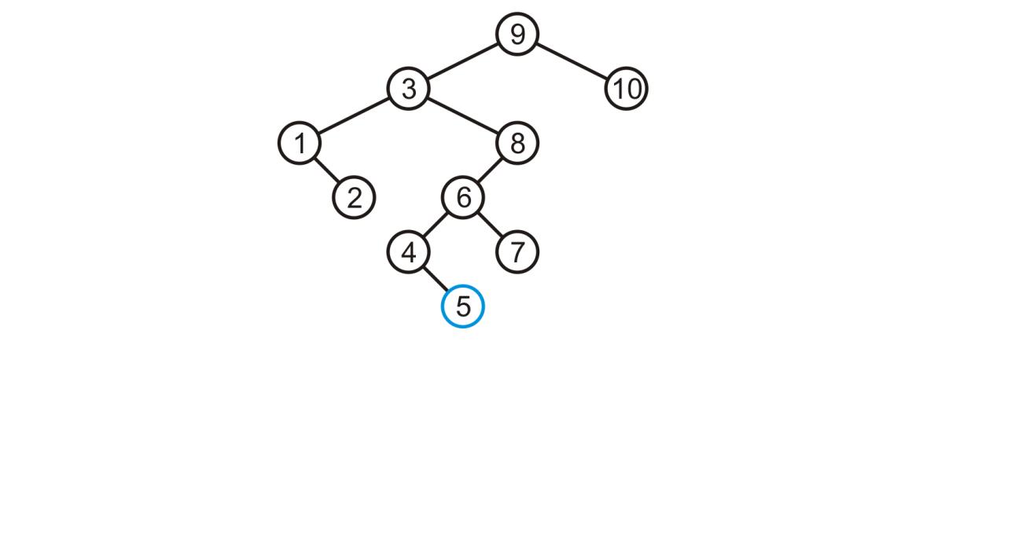
Examples
Accessing the deepest node, 5, we must begin with a zig-zag operation

Slide 45
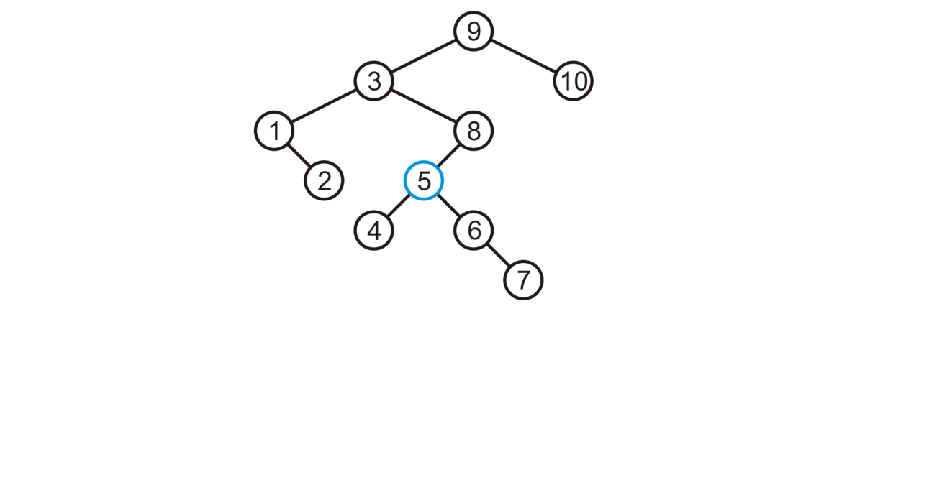
Examples
Next, we require a zig-zag operation to move 5 to the location of 3

Slide 46
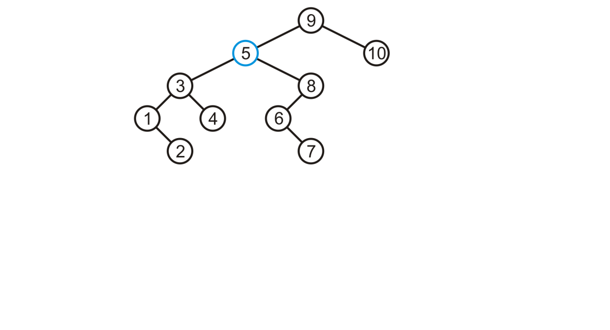
Examples
Finally, we require a single zig operation to move 5 to the root

Slide 47
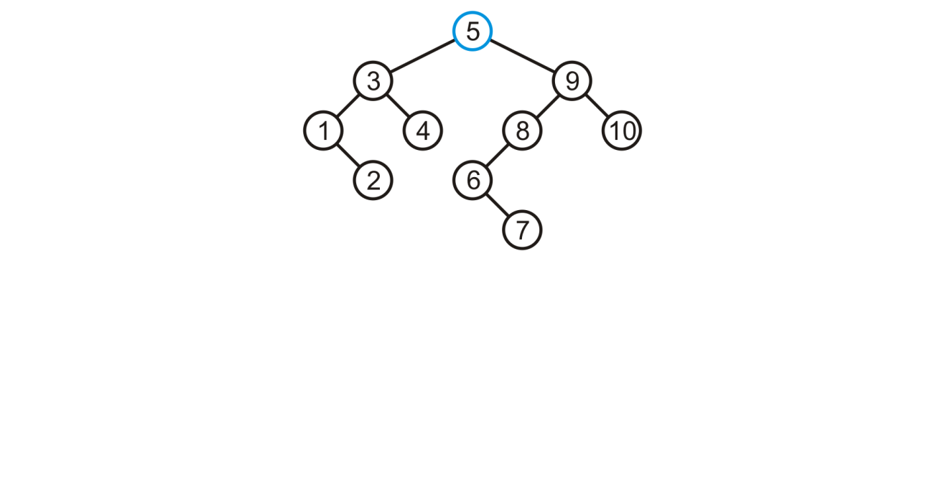
Examples
The height of the tree is 4; however, 7 of the nodes form a perfect tree at the root

Slide 48
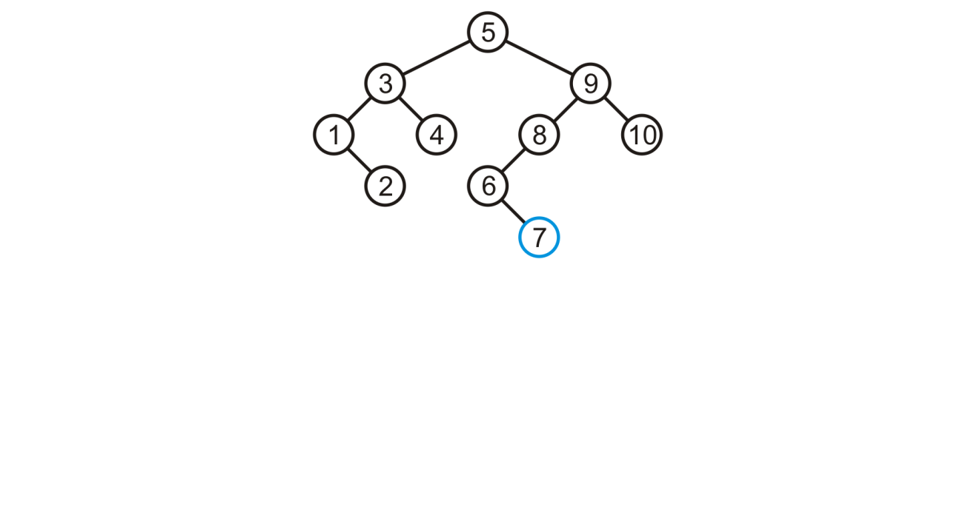
Examples
Accessing 7 will require two zig-zag operations

Slide 49
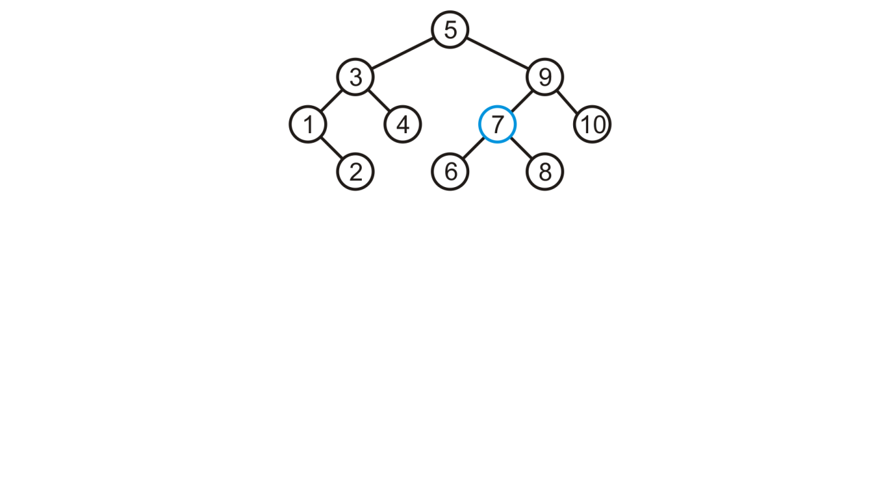
Examples
The first zig-zag moves it to depth 2

Slide 50
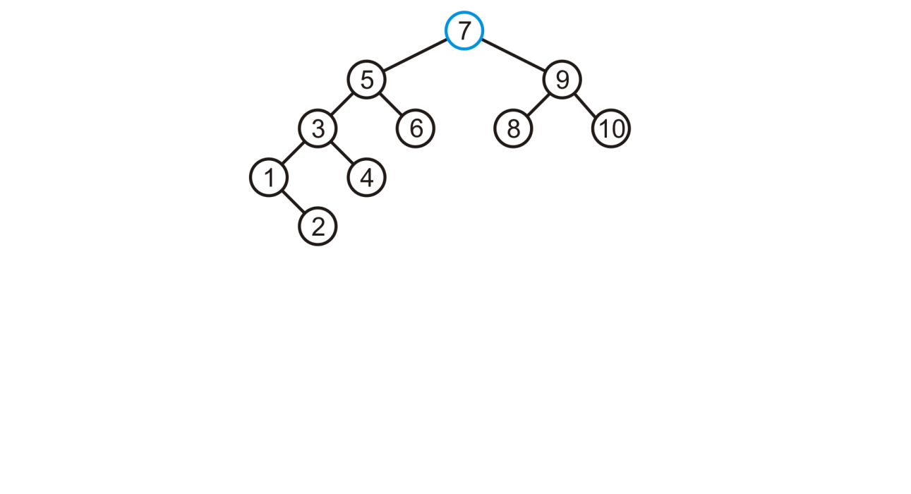
Examples
7 is promoted to the root through a zig-zag operation

Slide 51
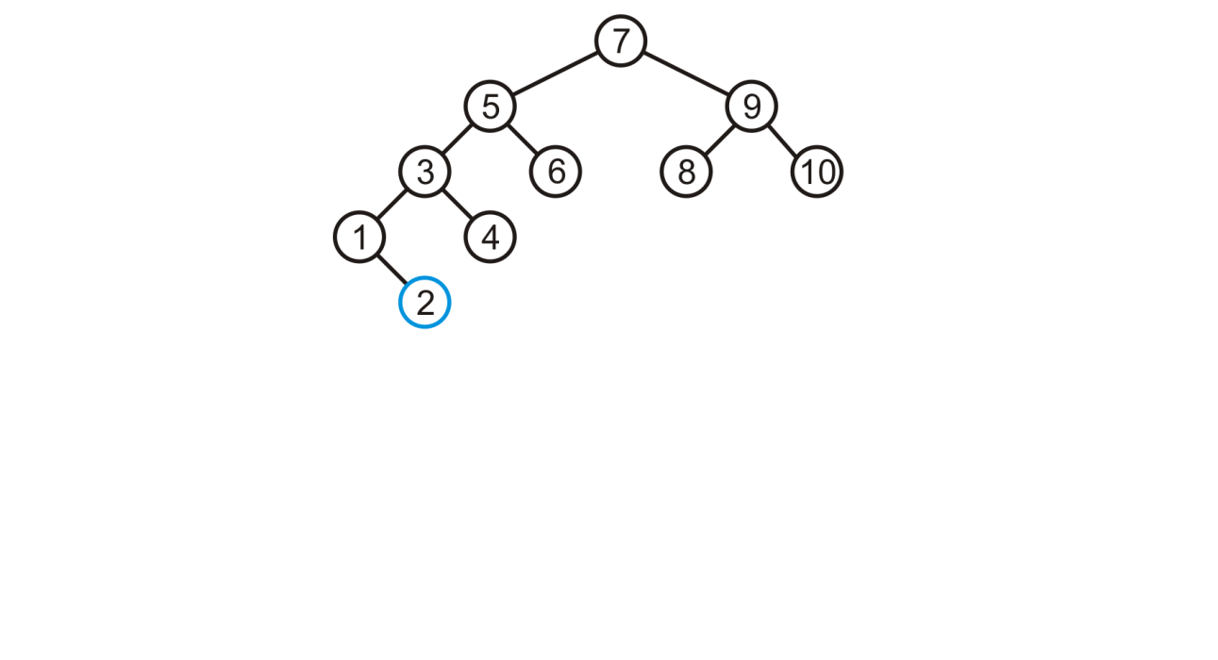
Examples
Finally, accessing 2, we first require a zig-zag operation

Slide 52
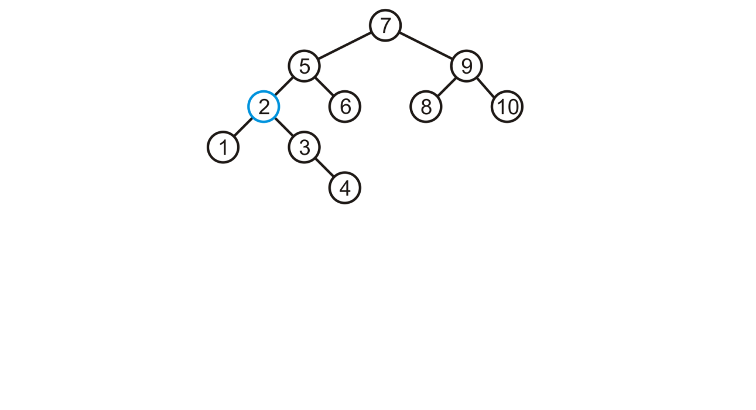
Examples
This now requires a zig-zig operation to promote 2 to the root

Slide 53
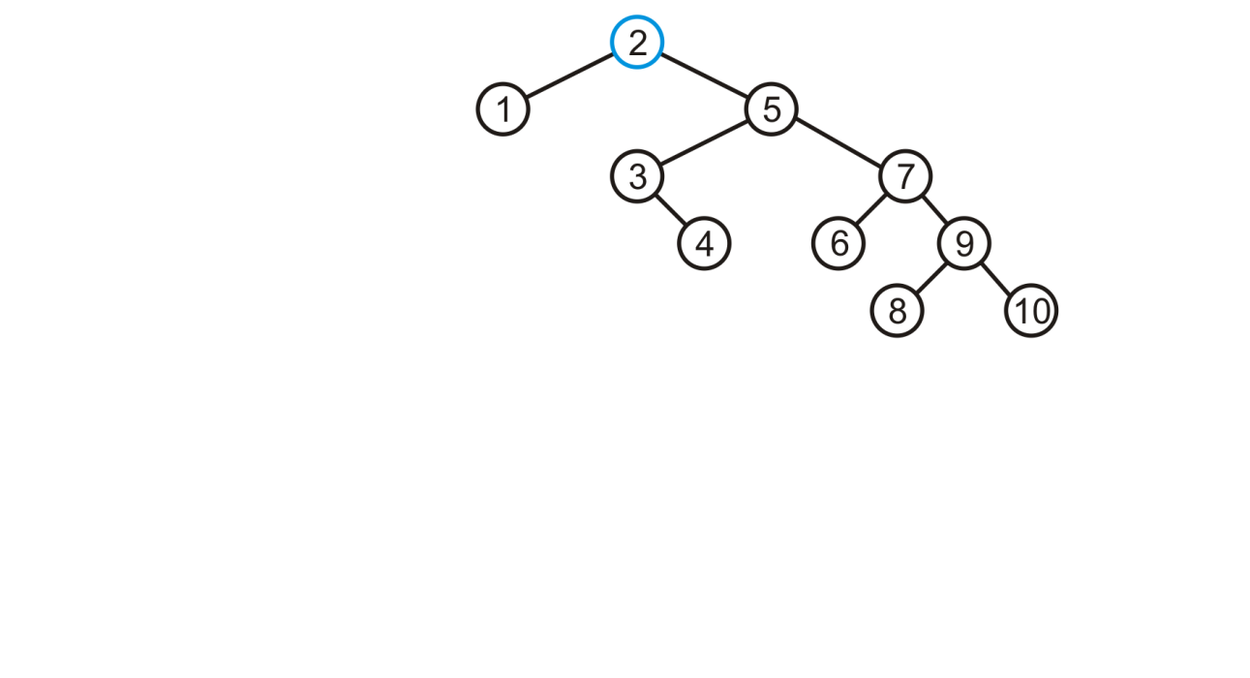
Examples
In this case, with 2 at the root, 3-10 must be in the right sub-tree
  The right sub-tree happens to be AVL balanced

Slide 54
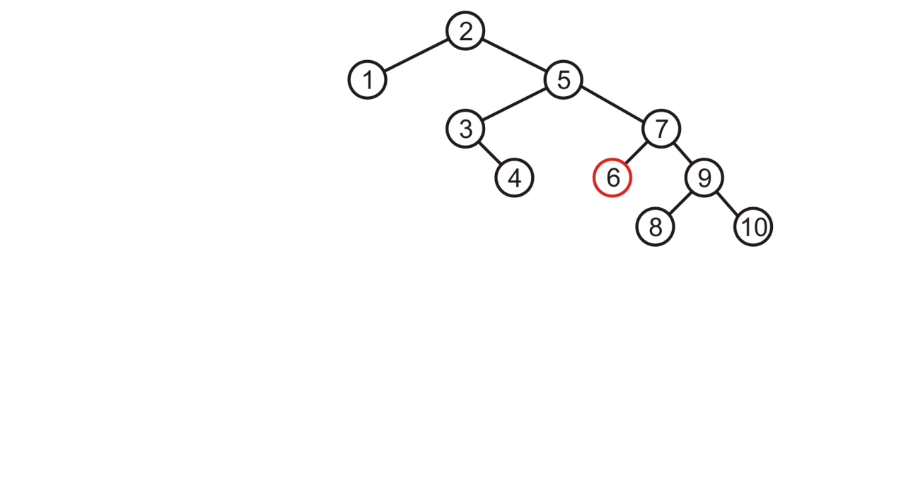
Examples
To remove a node, for example, 6, splay it to the root
  First we require a zig-zag operation

Slide 55
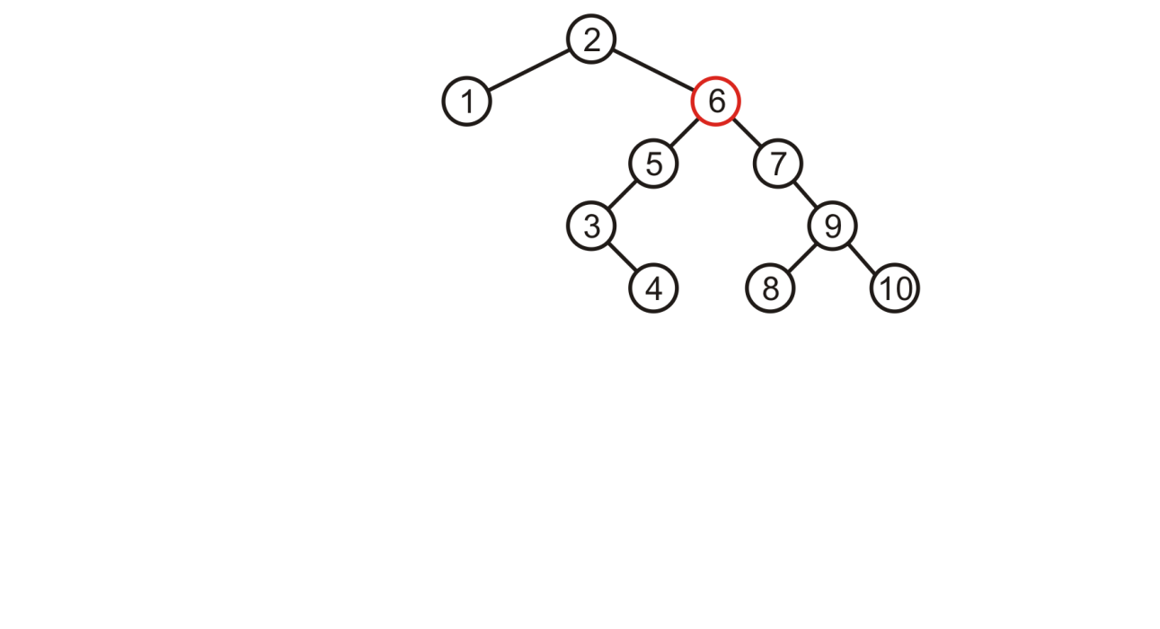
Examples
At this point, we need a zig operation to move 6 to the root

Slide 56
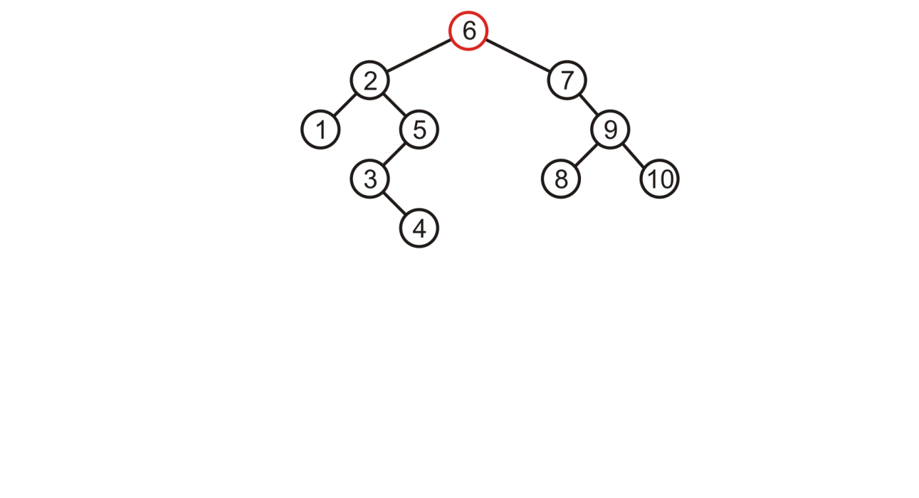
Examples
We will now copy the minimum element from the right sub-tree
  In this case, the node with 7 has a single sub-tree, we will simply move it up

Slide 57
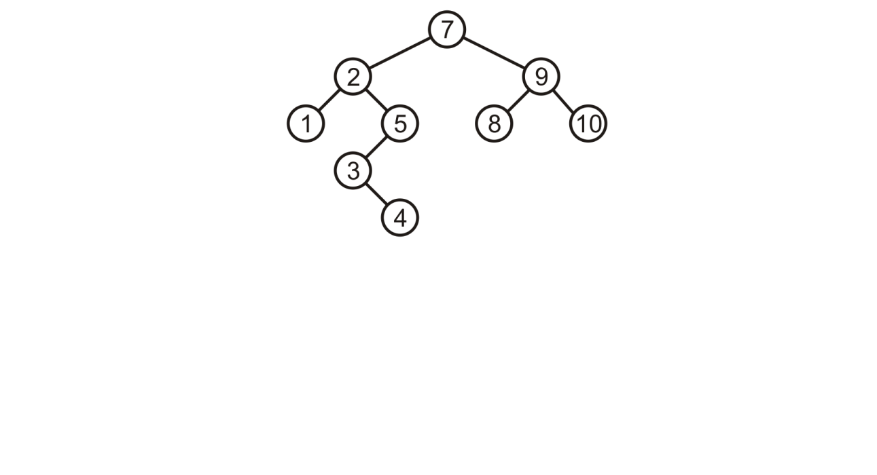
Examples
Thus, we have removed 6 and the resulting tree is, again, reasonably balanced

Slide 58
Performance
It is very difficult with small trees to demonstrate the amortized logarithmic behaviour of splay trees
The original ACM article proves the balance theorem:
  The run time of performing a sequence of m operations on a splay tree with n nodes is O( m(1 + ln(n)) + n ln(n) ).
Therefore the run time for a splay tree is comparable to any balanced tree assuming at least n operations

Slide 59
Performance
The ECE 250 web site has an implementation of splay trees at
http://ece.uwaterloo.ca/~ece250/Algorithms/Splay_trees/
It allows the user to export trees as SVG files

Slide 60
Comparisons
Advantages:
  The amortized run times are similar to that of AVL trees and red-black trees
  The implementation is easier
  No additional information (height/colour) is required
Disadvantages:
  The tree will change with read-only operations

Slide 61
Summary
This topic covers splay trees
  A binary search tree
  Splay accessed or inserted nodes to the root
  The height is O(n) but amortized run times of Θ(ln(n)) for Ω(n) operations
  Operations are termed zig, zig-zag and zig-zig
  Requires no additional memory

Slide 62
References
[1] Weiss, Data Structures and Algorithm Analysis in C++, 3rd Ed., Addison Wesley, §4.5, pp.149-58.
[2] Daniel D. Sleator and Robert E. Tarjan, "Self-Adjusting Binary Search Trees", Journal of the ACM 32 (3), 1985, pp.652-86.

Slide 63

Usage Notes
These slides are made publicly available on the web for anyone to use
If you choose to use them, or a part thereof, for a course at another institution, I ask only three things:
  that you inform me that you are using the slides,
  that you acknowledge my work, and
  that you alert me of any mistakes which I made or changes which you make, and allow me the option of incorporating such changes (with an acknowledgment) in my set of slides
  Sincerely,
  Douglas Wilhelm Harder, MMath
  dwharder@alumni.uwaterloo.ca

